Slide 1
GAS–VAPOR MIXTURES AND AIR-CONDITIONING

Slide 2
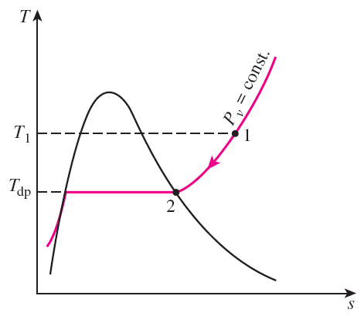

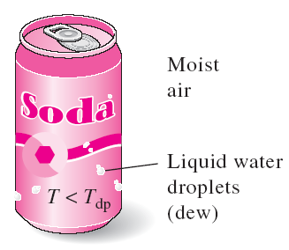
DEW-POINT TEMPERATURE
Dew-point temperature T_{dp}: The temperature at which condensation begins when the air is cooled at constant pressure (i.e., the saturation temperature of water corresponding to the vapor pressure.)
Constant-presssure cooling of moist
air and the dew-point temperature on
the T-s diagram of water.
When the temperature of a cold drink is below the dew-point temperature of the surrounding air, it “sweats.”

Slide 3
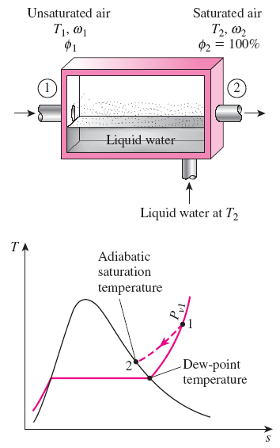
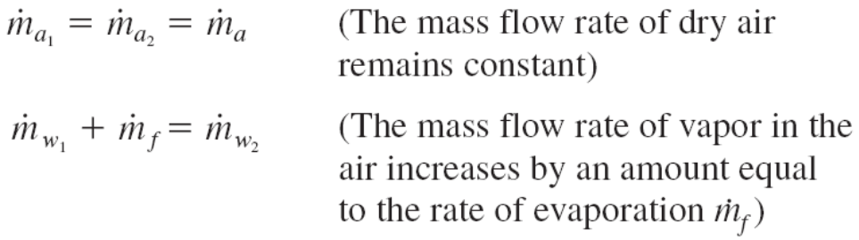


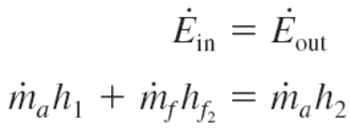


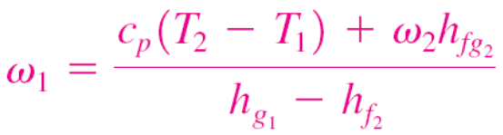
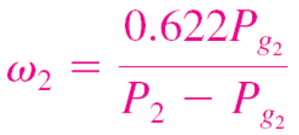
ADIABATIC SATURATION AND WET-BULB TEMPERATURES
The specific humidity (and relative humidity) of air can be determined from these equations by measuring the pressure and temperature of air at the inlet and the exit of an adiabatic saturator.
The adiabatic saturation process and its representation on a T-s diagram of water.

Slide 4
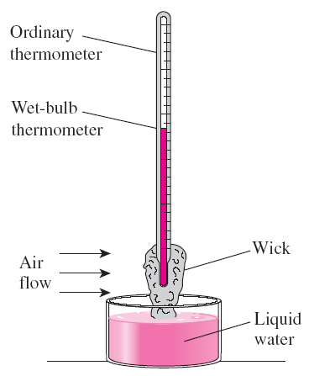
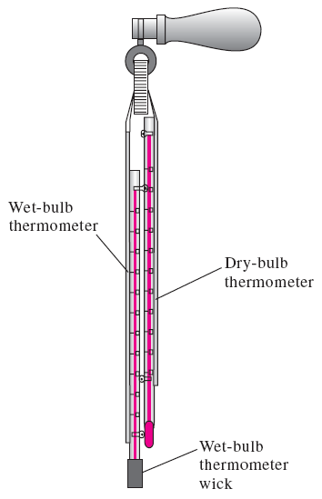
The adiabatic saturation process is not practical. To determine the absolute and relative humidity of air, a more practical approach is to use a thermometer whose bulb is covered with a cotton wick saturated with water and to blow air over the wick.
The temperature measured is the wet-bulb temperature T_{wb} and it is commonly used in A-C applications.
A simple arrangement to measure the wet-bulb temperature.
Sling psychrometer
For air–water vapor mixtures at atmospheric pressure, T_{wb} is approximately equal to the adiabatic saturation temperature.

Slide 5
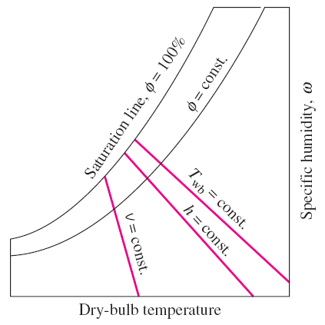
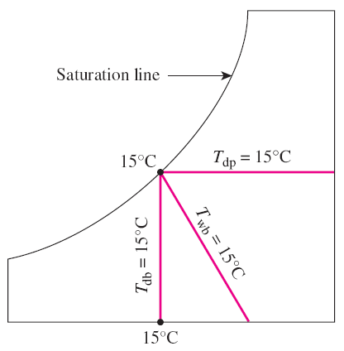
THE PSYCHROMETRIC CHART
Psychrometric charts: Present moist air properties in a convenient form. They are used extensively in A-C applications. The psychrometric chart serves as a valuable aid in visualizing the A-C processes such as heating, cooling, and humidification.
Schematic for a psychrometric chart.
For saturated air, the dry-bulb, wet-bulb, and dew-point temperatures are identical.

Slide 6
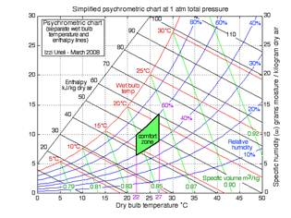
HUMAN COMFORT AND AIR-CONDITIONING
A body feels comfortable when it can freely dissipate its waste heat, and no more.

Slide 7
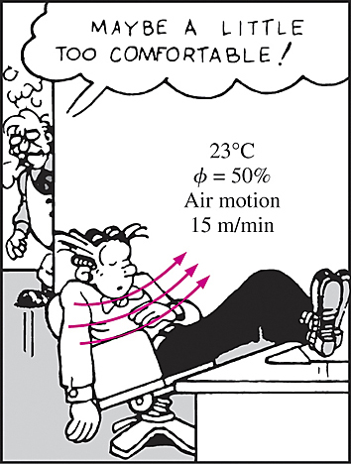
In an environment at 10°C with 48 km/h winds feels as cold as an environment at -7°C with 3 km/h winds as a result of the body-chilling effect of the air motion (the wind-chill factor).
The comfort of the human body depends primarily on three factors: the (dry-bulb) temperature, relative humidity, and air motion.
The relative humidity affects the amount of heat a body can dissipate through evaporation. Most people prefer a relative humidity of 40 to 60%.
Air motion removes the warm, moist air that builds up around the body and replaces it with fresh air. Air motion should be strong enough to remove heat and moisture from the vicinity of the body, but gentle enough to be unnoticed.
An important factor that affects human comfort is heat transfer by radiation between the body and the surrounding surfaces such as walls and windows.
Other factors that affect comfort are air cleanliness, odor, and noise.
A comfortable environment.

Slide 8
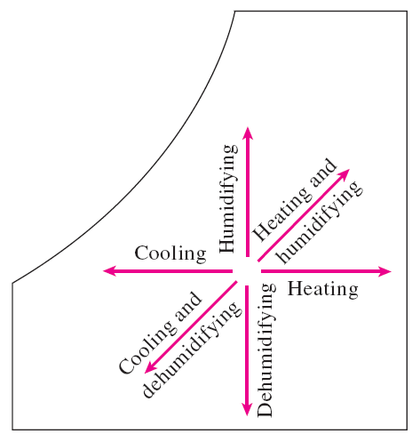
AIR-CONDITIONING PROCESSES
Maintaining a living space or an industrial facility at the desired temperature and humidity requires some processes called air-conditioning processes.
These processes include simple heating (raising the temperature), simple cooling (lowering the temperature), humidifying (adding moisture), and dehumidifying (removing moisture).
Sometimes two or more of these processes are needed to bring the air to a desired temperature and humidity level.
Air is commonly heated and humidified in winter and cooled and dehumidified in summer.
Various air-conditioning processes.

Slide 9

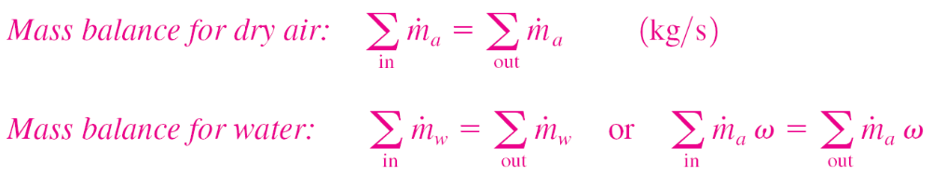


Most air-conditioning processes can be modeled as steady-flow processes with the following general mass and energy balances:
Mass balance
Energy balance
The work term usually consists of the fan work input, which is small relative to the other terms in the energy balance relation.

Slide 10
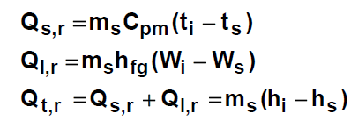


Slide 11
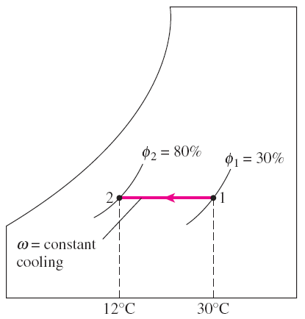


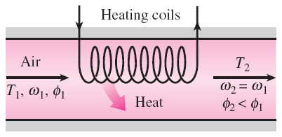
Simple Heating and Cooling (ω = constant)
Many residential heating systems consist of a stove, a heat pump, or an electric
resistance heater. The air in these systems is heated by circulating it through a duct that contains the tubing for the hot gases or the electric resistance wires.
Cooling can be accomplished by passing the air over some coils through which a refrigerant or chilled water flows.
Heating and cooling appear as a horizontal line since no moisture is added to or removed from the air.
During simple cooling, specific humidity remains constant, but relative humidity increases.
Dry air mass balance
Water mass balance
Energy balance
During simple heating, specific humidity remains constant, but relative humidity decreases.

Slide 12
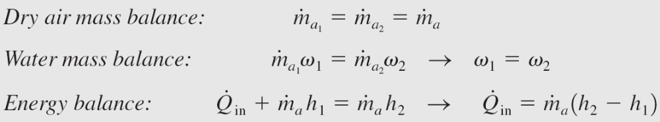
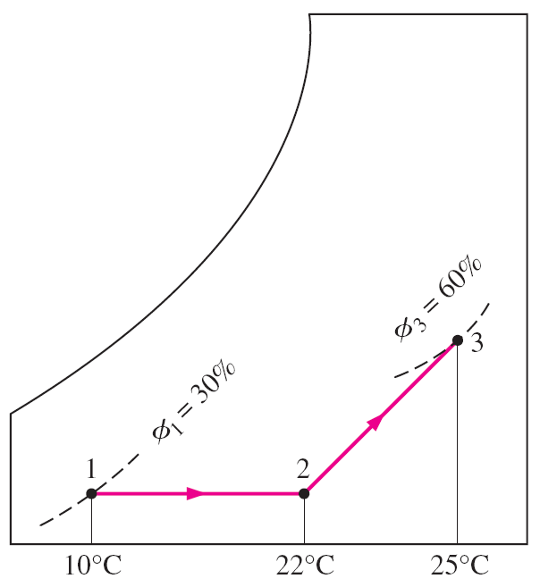


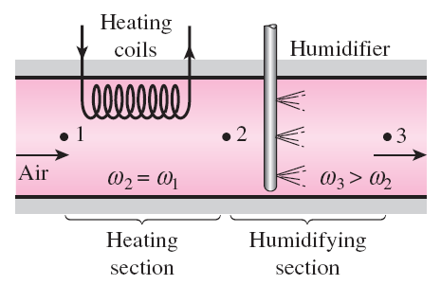
Heating with Humidification
Problems with the low relative humidity resulting from simple heating can be eliminated by humidifying the heated air. This is accomplished by passing the air first through a heating section and then through a humidifying section.

Slide 13
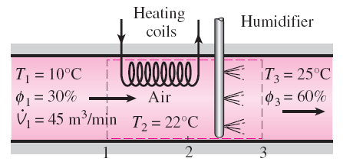
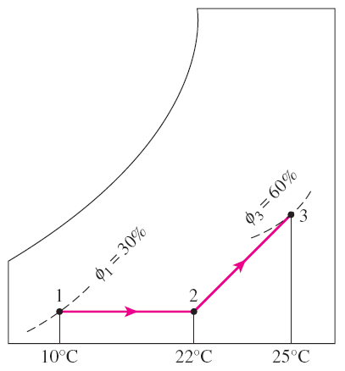
AN EXAMPLE

Slide 14
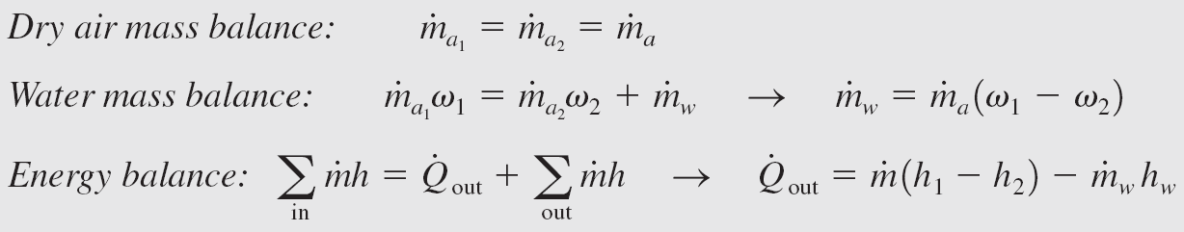
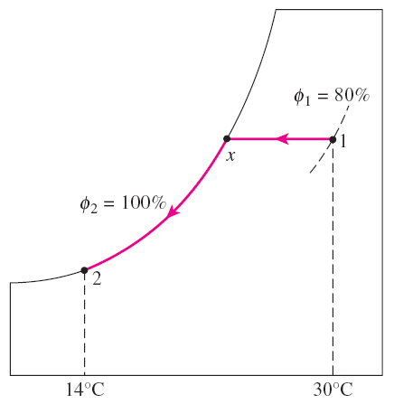
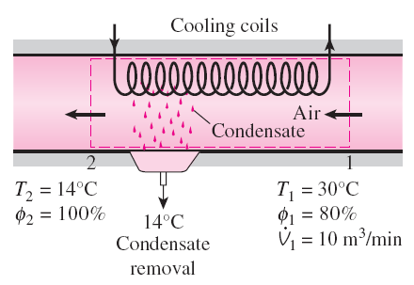
Cooling with Dehumidification
The specific humidity of air remains constant during a simple cooling process, but its relative humidity increases. If the relative humidity reaches undesirably high levels, it may be necessary to remove some moisture from the air, that is, to dehumidify it. This requires cooling the air below its dew-point temperature.

Slide 15
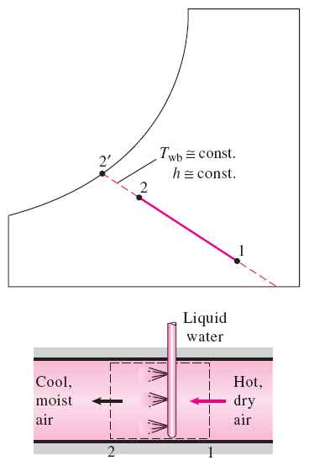


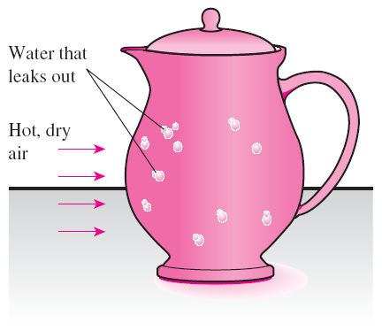
In desert (hot and dry) climates, we can avoid the high cost of conventional cooling by using evaporative coolers, also known as swamp coolers.
As water evaporates, the latent heat of vaporization is absorbed from the water body and the surrounding air. As a result, both the water and the air are cooled during the process.
Evaporative Cooling
This process is essentially identical to adiabatic saturation process.
Water in a porous jug left in an open, breezy area cools as a result of evaporative cooling.

Slide 16
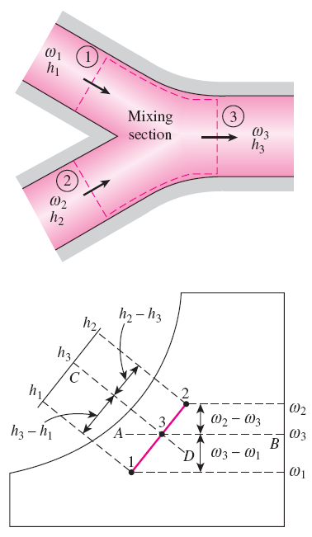
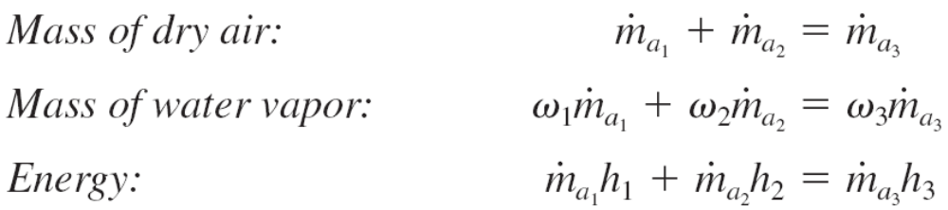
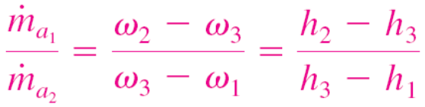
Adiabatic Mixing of Airstreams
Many A-C applications require the mixing of two airstreams. This is particularly true for large buildings, most production and process plants, and hospitals, which require that the conditioned air be mixed with a certain fraction of fresh outside air before it is routed into the living space.
When two airstreams at states 1 and 2 are mixed adiabatically, the state of the mixture lies on the straight line connecting the two states.

Slide 17
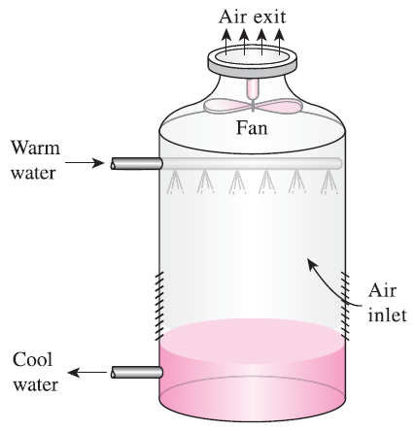
Wet Cooling Towers
Power plants, large air-conditioning systems, and some industries generate large quantities of waste heat that is often rejected to cooling water from nearby lakes or rivers.
In some cases, however, the cooling water supply is limited or thermal pollution is a serious concern.
In such cases, the waste heat must be rejected to the atmosphere, with cooling water recirculating and serving as a transport medium for heat transfer between the source and the sink (the atmosphere).
One way of achieving this is through the use of wet cooling towers.
A wet cooling tower is essentially a semi-enclosed evaporative cooler.
An induced-draft counterflow cooling tower.

Slide 18
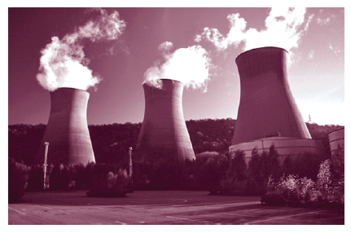
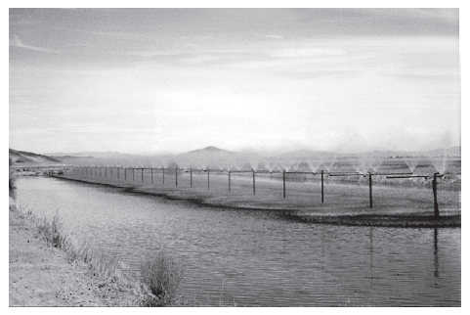
Natural-draft cooling tower: It looks like a large chimney and works like an ordinary chimney. The air in the tower has a high water-vapor content, and thus it is lighter than the outside air. Consequently, the light air in the tower rises, and the heavier outside air fills the vacant space, creating an airflow from the bottom of the tower to the top.
Spray pond: The warm water is sprayed into the air and is cooled by the air as it falls into the pond,
Cooling pond: Dumping the waste heat into a still pond, which is basically a large artificial lake open to the atmosphere.
Two natural draft cooling towers on a roadside.
A spray pond.

Slide 19
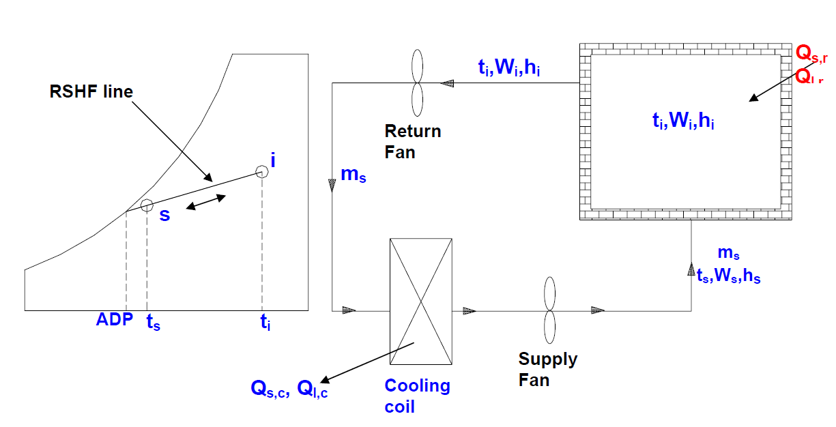

Slide 20
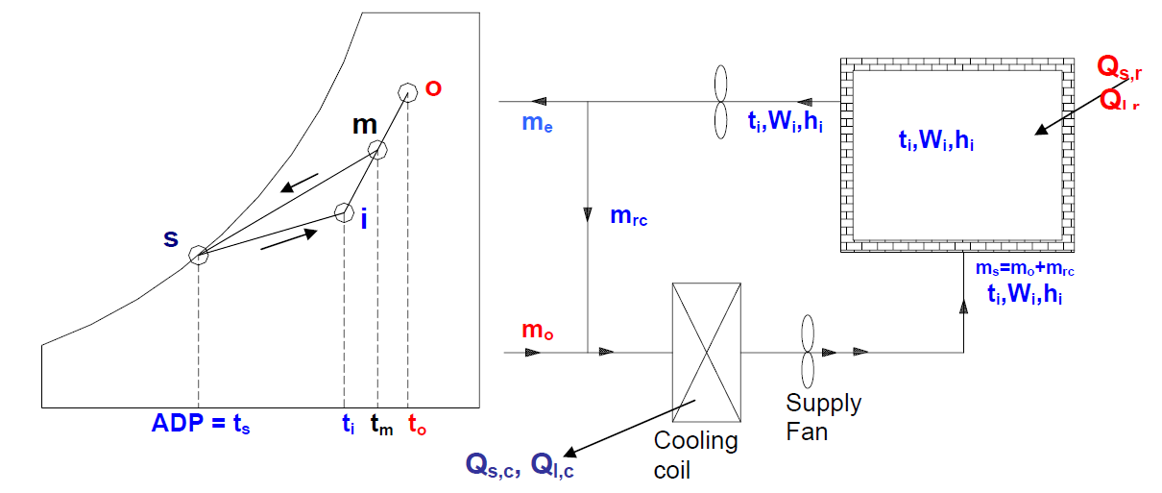

Slide 21
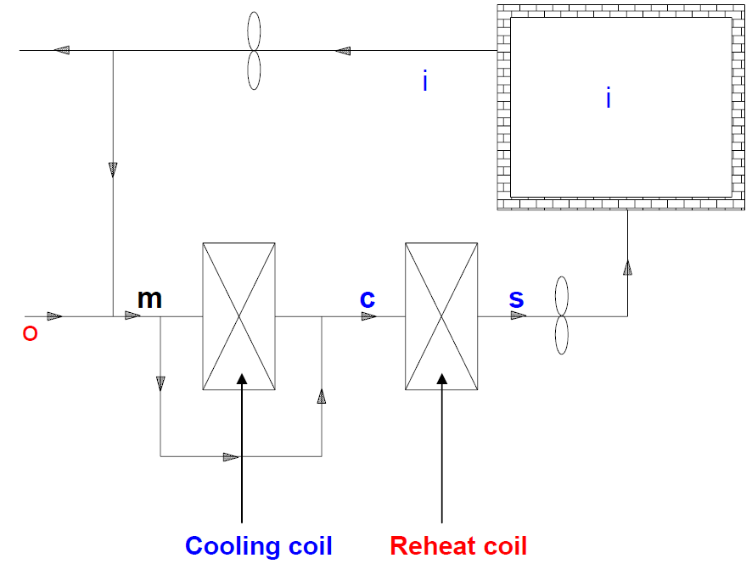
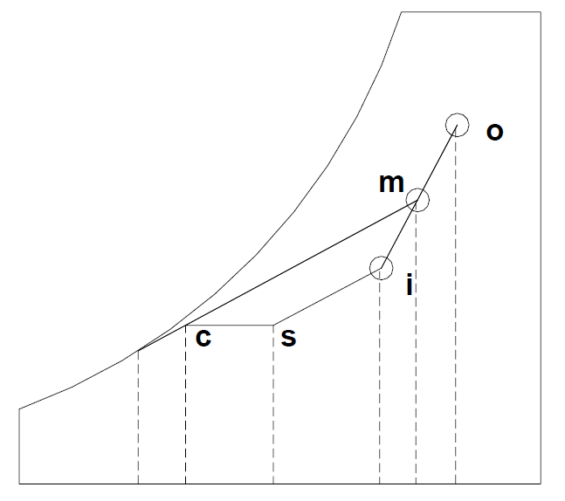

Slide 22
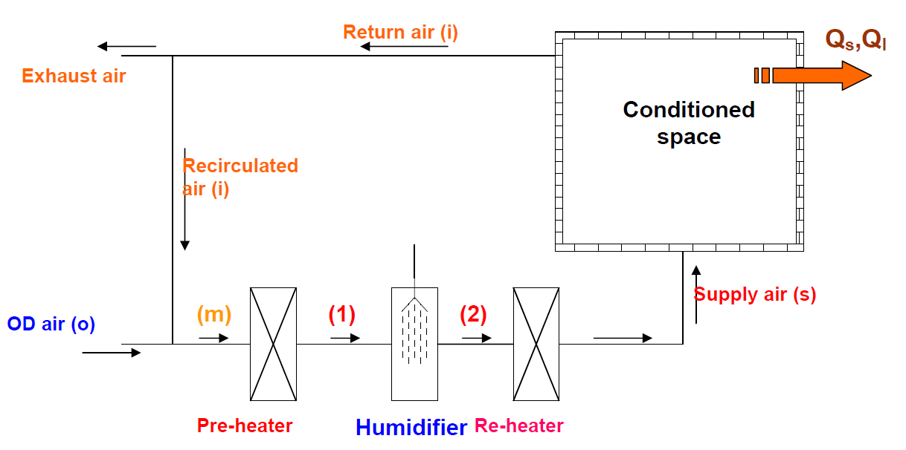
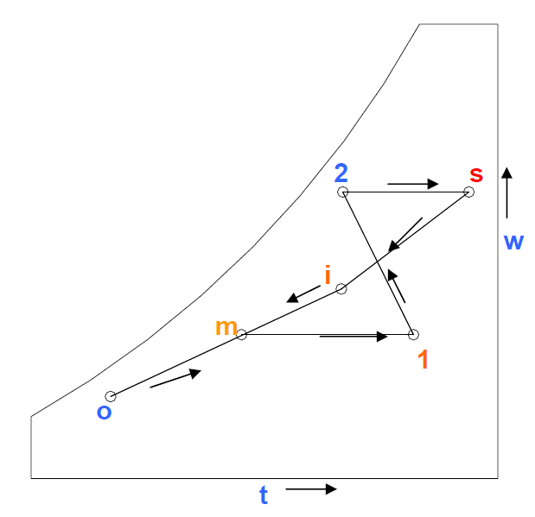

Slide 23
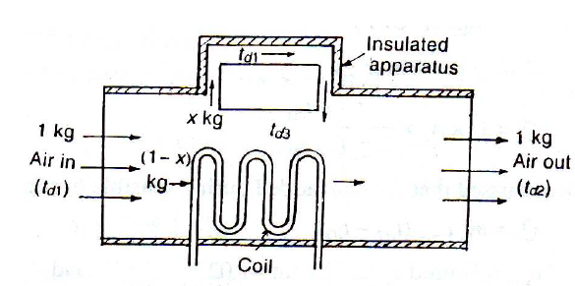
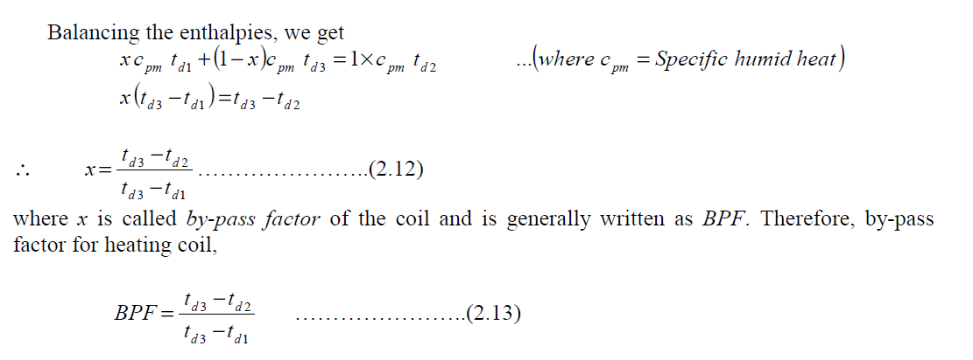

Slide 24
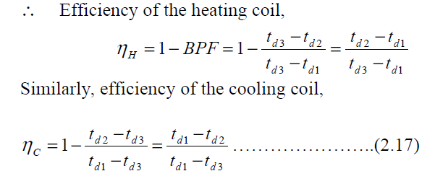

Slide 25
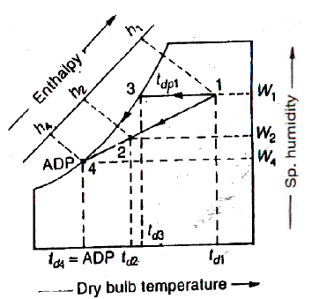

Slide 26
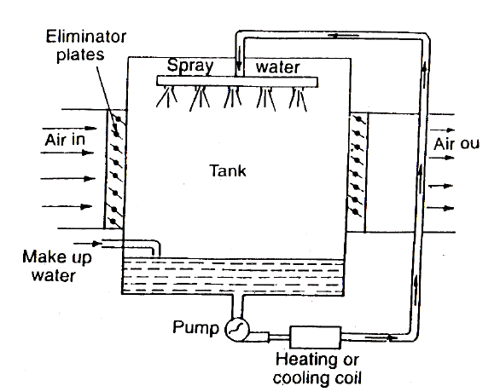

Slide 27
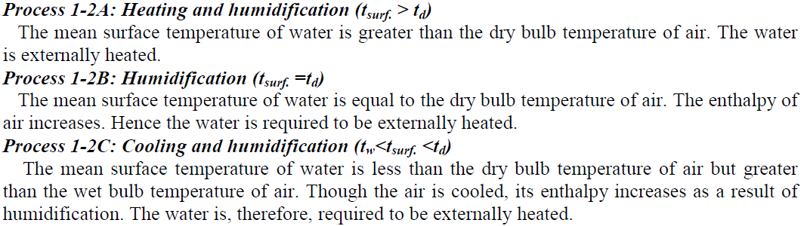
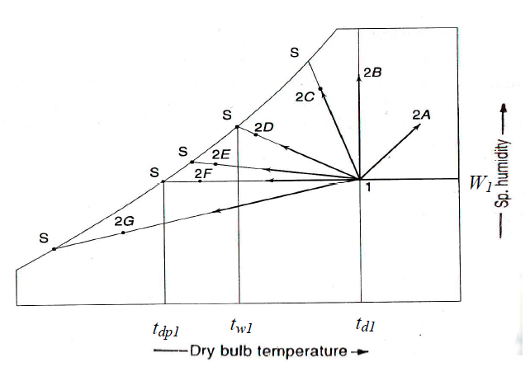

Slide 28
